Slide 1
Big Data
Analytic Software Pod 6 Presentation
Jay Noppone P, Abdul Andha, Olu Kukoyi, Nur Mazumder, Mansij Mishra, Tajwar Rahman

Slide 2






The Team
Abdul Andha
Olu Kukoyi
Nur Mazumder
Jay Noppone P
Tajwar Rahman
Mansij Mishra

Slide 3
Agenda
01
02
03
04
05
06
Overview
History
Benchmarking
Overview of Big Data tools and their advantages
How did Big Data tools originate
Benchmark of industry options
Relevance
Recommendation
QnA
Big Data’s prevalence in the industry
What we recommend
Questions and Answers

Slide 4
01
Overview

Slide 5
What are Big Data tools?
Big Data refers to vast amounts of structured and unstructured data, that are sourced from social media, IoT devices, and online interactions. These datasets are so huge and complex, that traditional data management systems struggle store, process, and analyse them efficiently.
For these reason, new Big Data Tools are emerging to help companies handle continuous data streams from various sources, making it possible to process data in real-time, monitor events as they happen, and quickly gain actionable insights. Some tools include Apache Kafka, Amazon Kinesis, Google Cloud Dataflow.

Slide 6
Advantages of Big Data Tools
Scalability
Real-time processing
These tools expand capacity by adding servers rather than upgrading hardware.
They dynamically adjust resources to handle varying data loads.
Tools like Kafka and Kinesis support global, distributed data processing.
Data is ingested and processed within seconds for time-sensitive applications.
These tools support real-time analytics, essential for fields like finance and healthcare.
They enable systems to react instantly to incoming data events.
Notes:
Scalability "One of the main advantages of Big Data tools is their impressive scalability. These tools are built for horizontal scaling, meaning they can handle large numbers of users and vast volumes of data by adding more servers rather than upgrading individual ones, which keeps costs down. They also offer elastic scaling, automatically adjusting resources based on demand, making them highly adaptable for fluctuating data loads. Google Cloud Dataflow, for example, scales in real time, ideal for variable workloads. Tools like AWS Kinesis and Apache Kafka enable global scale and distribution, allowing data sources and consumers to be geographically dispersed, which is crucial for global applications with diverse data needs." Data lakes and warehouses benefit from this scalability, as they are designed to store and process massive, distributed datasets fed by these Big Data tools.
2. Real-Time Processing "Another advantage is real-time processing, enabling these tools to handle streaming data with minimal latency. For instance, AWS Kinesis can ingest data within seconds, making it perfect for time-sensitive applications like IoT monitoring or social media analytics. They also allow for continuous analytics, empowering businesses to analyze data on the fly, which is essential in sectors like finance for real-time fraud detection or healthcare for monitoring patients. Additionally, Kafka and Kinesis support event-driven architectures, which allow systems to respond instantly as new data arrives—a necessity for applications that require immediate responses." This real-time processing capability allows data lakes and warehouses to continuously update, providing immediate, actionable insights.

Slide 7
Advantages of Big Data Tools
Efficiency
Community Support
Tools like Dataflow and Kinesis automatically optimize resource use, reducing costs.
High throughput capabilities reduce processing delays and prevent bottlenecks.
Built-in fault tolerance ensures data integrity and minimizes downtime.
Each tool integrates well with cloud and third-party services, with ample documentation.
Regular updates and support keep these tools aligned with the latest data needs and innovations.
Notes:
3. Efficiency "Big Data tools also deliver high efficiency. They use optimized resource management to keep operational costs low, with tools like Dataflow and Kinesis allocating resources dynamically to reduce energy use. Their high-throughput capabilities ensure that data is processed as it’s ingested, minimizing latency and preventing bottlenecks, making it easier to handle heavy workloads. These tools also have strong fault tolerance and reliability. For example, Kafka replicates data across nodes, while Kinesis stores data in multiple availability zones, ensuring data integrity and minimizing the chance of downtime." Efficiency and fault tolerance ensure that data lakes and warehouses can rely on consistent, high-quality data streams.
4. Community Support "Finally, community support plays a significant role in the strength of these tools. For instance, Kafka’s open-source foundation means it has a large community continuously improving it, ensuring it stays adaptable and well-supported. These tools integrate seamlessly with major cloud services and a variety of third-party applications, backed by extensive documentation, user forums, and troubleshooting resources. They also benefit from regular innovation and updates. Google Cloud Dataflow, for example, leverages Google’s expertise in machine learning and data management, keeping it at the forefront of modern data needs." Community-driven updates enhance compatibility with evolving data lake and warehousing technologies, fostering integration and innovation.

Slide 8
02
History

Slide 9
History of Kafka, Google Cloud, & AWS
Apache Kafka
AWS Kinesis
Google Cloud Dataflow
- Developed by LinkedIn engineers in 2011 for processing streaming data in real time
- Originally open-sourced but became a project under the Apache Software Foundation
- Designed to operate as a distributed commit log, offering high scalability and fault tolerance
- Introduced by Amazon in 2013 to meet the demand for real-time data streaming on AWS
- Initially launched as Kinesis Streams, later expanded to include: Kinesis Firehose, Kinesis Data Analytics, Kinesis Video Streams
- Became widely adopted for IoT, clickstream, and event-driven applications within the AWS ecosystem
- Launched by Google in 2015, built on Google’s internal tools like MapReduce, Flume, and MillWheel
- Based on the Apache Beam model, which unifies stream and batch processing under one API
- Influential in popularizing serverless, managed data processing solutions, especially for Google Cloud Platform users

Slide 10
03
Benchmarking

Slide 11
Tabular Comparison
Criteria | Apache Kafka | AWS Kinesis | GCP Dataflow
Learning Curve | Steep | Moderate | Low to Moderate
Use Case | Real-time analytics, event streaming, ETL | Real-time data streaming and analytics | Real-time data processing, ETL
Flexibility | Open source | Managed by AWS | Managed by GCP
Pricing | Self-hosted infrastructure | Pay-as-you-go model based on usage | Pay-as-you-go model based on usage
Scalability | Highly scalable; distributed structure | Automatically scalable within AWS | Automatically Scalable within GCP

Slide 12
04
Industry & Academic Relevance

Slide 13

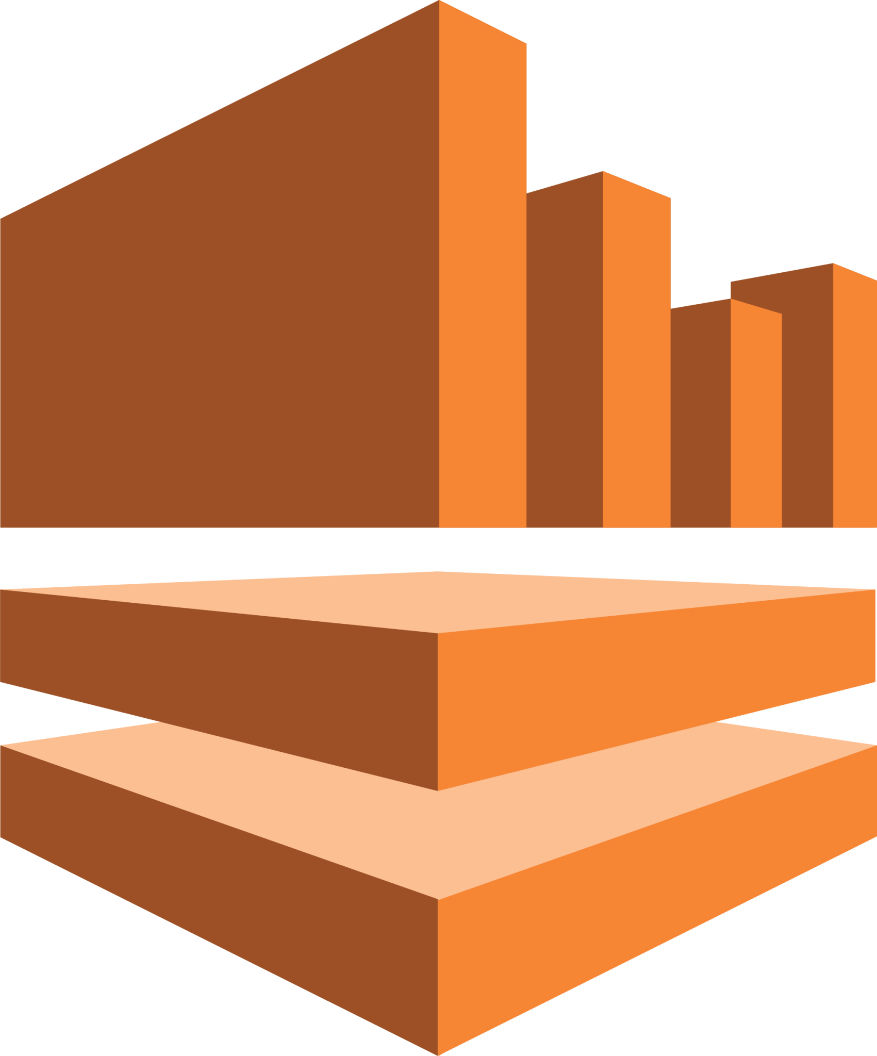
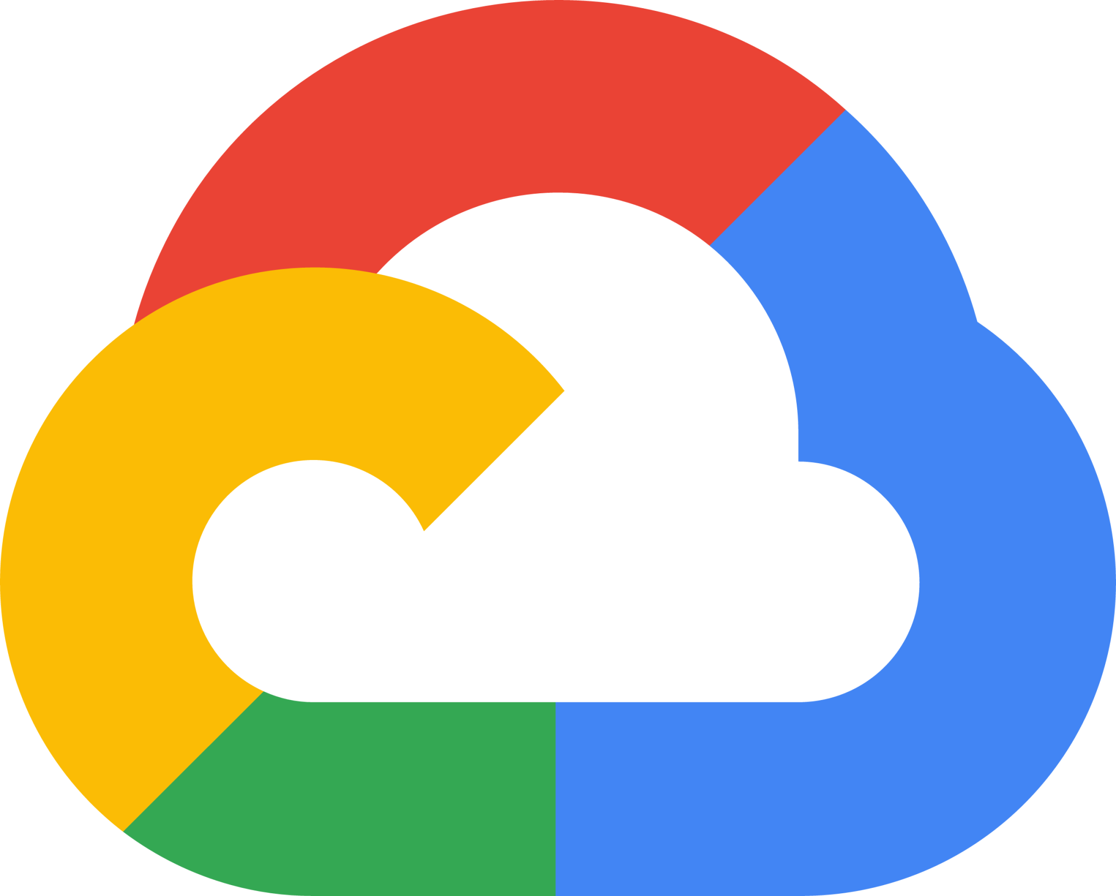
Large-scale real-time data processing
High-usage demand
High customer base
LinkedIn, Uber, Netflix, JP Morgan Chase, PayPal
Smaller end of large-scale companies
Requires real-time processing, but room for latency
Streaming & entertainment
Disney+, Comcast, Twitch
Large-scale companies
Less-intensive real-time processing
Benefits from Google’s ML and BigQuery products
Twitter, The New York Times, Spotify

Slide 14
05
Recommendation

Slide 15
Recommendations
Google Cloud Dataflow
Auto-scaling
Cost Efficiency
Unified Processing
Automatically adjusts resources based on data volume, ensuring efficient performance for fluctuating workloads, such as monitoring real-time user behavior or transaction processing.
Serverless, pay-per-use model helps control costs, making it ideal for unpredictable workloads like event-driven analytics.
Combines both streaming and batch processing in one platform, ideal for use cases like real-time analytics and IoT sensor data, where both real-time and periodic batch analysis are needed.

Slide 16
QnA

Slide 17
Thank you!

